Slide 1

DAX : Data Analysis Expressions
is a formula expression language
DAX formulas include functions, operators, and values
Creates new information from data already in your model
DAX formulas are used to create
Measures
Calculated Columns
Calculated Tables
All the computations are generated at Data Model

Slide 2
DAX : Data Analysis Expressions
Measures
DAX
Calculated Columns
Calculated Tables
Existing Table
Product | Unit Price | Quantity
Calculated Table

Slide 3
DAX : Data Analysis Expressions
DAX
Measures
Calculated Columns
Product | Unit Price | Quantity
Sales
Calculated Tables
Calculated Column

Slide 4
DAX : Data Analysis Expressions
Product | Unit Price | Quantity | Sales
Measures
Calculated Columns
DAX
Calculated Tables
Total Sales = 10.4 M
Measure

Slide 5
DAX : Data Analysis Expressions
Measures
dynamic calculation formulas resulting in a single value
Performed at the time of data analysis
Respond to user interactions, such as filtering, drilling down, or slicing data
Calculated Columns
a column that you add to an existing table
a DAX formula defines the column's values based on existing columns in the dataset
Computed during data refresh
Static and cannot be changed based on user interactions
Calculated Tables
Table computed using DAX formulas
Not present in original data source data source but are created based on existing data and calculations

Slide 6
Calculated Tables
Select Specific Columns
Add new columns
Aggregated Columns
Single Column table
ALL()
ALLSELECTED()
ALLEXCEPT()
ADDCOLUMNS()
SELECTCOLUMNS()
GROUPBY()
SUMMARIZE()
TOPN()
DISTINCT()
VALUE()
Time Intelligence
CALENDAR()
CALENDARAUTO()

Slide 7
Calculated Columns
Text
Date & Time
Mathematical
Logical
CONCATENATE()
YEAR(), MONTH(), etc.
EOMONTH()
DATEDIFF()
DIVIDE()
MROUND()
FLOOR()/ CEILING()
IF()
SWITCH()
COALESCE()
AND()/OR()/NOT()
TRUE()
Information
ISBLANK()

Slide 8
Calculated Values : Measures
Aggregation
Iterator
Time Intelligence
SUM()
AVERAGE()
COUNT()
DISTINCTCOUNT()
MIN()/MAX()
SUMX()
AVERAGEX()
COUNTX()
MINX()/MAXX()
TOTALMTD()
TOTALQTD()
TOTALYTD()
CALCULATE()
Modifiers

Slide 9
SUM(table[Quantity])
AVERAGE(table[Quantity])
Sales ID | Product ID | Quantity | Price
1 | 101 | 5 | 10
2 | 102 | 3 | 15
3 | 101 | 2 | 10
4 | 103 | 6 | 8
MIN(table[Quantity])
MAX(table[Quantity])
COUNT(table[Product ID])
COUNTDISTINCT(table[Product ID])

Slide 10
Sales ID | Product ID | Quantity | Price
1 | 101 | 5 | 10
2 | 102 | 3 | 15
3 | 101 | 2 | 10
4 | 103 | 4 | 8
Quantity
5
3
2
4
Quantity | Price
5 | 10
3 | 15
2 | 10
4 | 8
Sales = Quantity * price
5* 10 = 50
3 * 15 = 45
2 * 10 = 20
4 * 8 = 32
Total Sales = 147
SUM(table[Quantity])
SUMX(table, table[Quantity]* table[Price])

Slide 11
What is total sales for country India?
CALCULATE(SUM(table[sales]),
table[country] = “India”)
What is total sales for previous month?
CALCULATE( SUM(table[sales]),
PREVIOUSMONTH(table[Date])
CALCULATE( SUM(table[sales]),
DATEADD(table[Date], -1, MONTH)
SUM(table[sales])
Calculate total sales while removing all or some filters
CALCULATE(
SUM(table[sales]),
ALL()/ALLSELECTED()/ALLEXCEPT()/REMOVEFILTERS())
Calculate total sales and add filters
CALCULATE(SUM(table[sales]), KEEPFILTERS())

Slide 12
What is total sales for country India?
CALCULATE(SUM(table[sales]),
FILTER(table, table[country] = “India”)
What is total sales for previous month?
CALCULATE( SUM(table[sales]),
PREVIOUSMONTH(table[Date])
CALCULATE( SUM(table[sales]),
DATEADD(table[Date], -1, MONTH)
SUM(table[sales])
Calculate total sales while removing all or some filters
CALCULATE(
SUM(table[sales]),
ALL()/ALLSELECTED()/ALLEXCEPT()/REMOVEFILTERS())
Calculate total sales and add filters
CALCULATE(SUM(table[sales]), KEEPFILTERS())

Slide 13
What is total sales for country India?
CALCULATE(SUM(table[sales]),
FILTER(table, table[country] = “India”)
What is total sales for previous month?
CALCULATE( SUM(table[sales]),
PREVIOUSMONTH(table[Date])
CALCULATE( SUM(table[sales]),
DATEADD(table[Date], -1, MONTH)
SUM(table[sales])
Calculate total sales while removing all or some filters
CALCULATE(
SUM(table[sales]),
ALL()/ALLSELECTED()/ALLEXCEPT()/REMOVEFILTERS())
Calculate total sales and add filters
CALCULATE(SUM(table[sales]), KEEPFILTERS())

Slide 14
What is total sales for country India?
CALCULATE(SUM(table[sales]),
FILTER(table, table[country] = “India”)
What is total sales for previous month?
CALCULATE( SUM(table[sales]),
PREVIOUSMONTH(table[Date].[date])
CALCULATE( SUM(table[sales]),
DATEADD(table[Date].[date], -1, MONTH)
SUM(table[sales])
Calculate total sales while removing all or some filters
CALCULATE(
SUM(table[sales]),
ALL()/ALLSELECTED()/ALLEXCEPT()/REMOVEFILTERS())
Calculate total sales and add filters
CALCULATE(SUM(table[sales]), KEEPFILTERS())

Slide 15
What is total sales for country India?
CALCULATE(SUM(table[sales]),
FILTER(table, table[country] = “India”)
What is total sales for previous month?
CALCULATE( SUM(table[sales]),
PREVIOUSMONTH(table[Date].[date])
CALCULATE( SUM(table[sales]),
DATEADD(table[Date].[date], -1, MONTH)
SUM(table[sales])
Calculate total sales while removing all or some filters
CALCULATE(
SUM(table[sales]),
ALL()/ALLSELECTED()/ALLEXCEPT()/REMOVEFILTERS())
Calculate total sales and add filters
CALCULATE(SUM(table[sales]), KEEPFILTERS())

Slide 16
Order ID | Product | Quantity
A-01 | Binder | 10
A-01 | Paper | 25
A-24 | Chairs | 6
A-24 | Tables | 1
B-152 | Phone | 1
B- 300 | Books | 50
B- 300 | Bookcases | 3
Order ID | Returned
A-24 | Yes
B- 300 | Yes
*
1
Returns
Orders

Slide 17
RELATED(Returns[Returned])
Order ID | Returned | Product | Quantity
A-01 |  | Binder | 10
A-01 |  | Paper | 25
A-24 | Yes | Chairs | 6
A-24 | Yes | Tables | 1
B-152 |  | Phone | 1
B- 300 | Yes | Books | 50
B- 300 | Yes | Bookcases | 3
Order ID | Returned
A-24 | Yes
B- 300 | Yes
*
1
Returns
Orders

Slide 18
Returned = RELATED(Returns[Returned])
Order ID | Returned | Product | Quantity
A-01 |  | Binder | 10
A-01 |  | Paper | 25
A-24 | Yes | Chairs | 6
A-24 | Yes | Tables | 1
B-152 |  | Phone | 1
B- 300 | Yes | Books | 50
B- 300 | Yes | Bookcases | 3
Order ID | Returned
A-24 | Yes
B- 300 | Yes
*
1
Returns
Orders

Slide 19
Order ID | Product | Quantity
A-01 | Binder | 10
A-01 | Paper | 25
A-24 | Chairs | 6
A-24 | Tables | 1
B-152 | Phone | 1
B- 300 | Books | 50
B- 300 | Bookcases | 3
*
1
Order ID | Returned | Quantity Returned
A-24 | Yes | 7
B- 300 | Yes | 53
6 + 1
50 + 3
Returns
Orders
RELATEDTABLE(Orders)

Slide 20
Order ID | Product | Quantity
A-01 | Binder | 10
A-01 | Paper | 25
A-24 | Chairs | 6
A-24 | Tables | 1
B-152 | Phone | 1
B- 300 | Books | 50
B- 300 | Bookcases | 3
*
1
Order ID | Returned | Quantity Returned
A-24 | Yes | 7
B- 300 | Yes | 53
6 + 1
50 + 3
Returns
Orders
Quantity Returned = SUMX(RELATEDTABLE(Orders), Orders[Quantity])

Slide 21
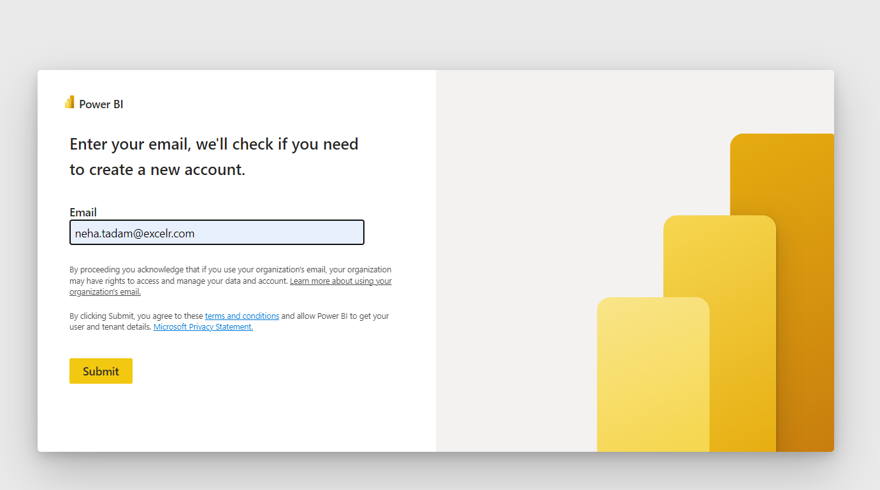

Slide 22
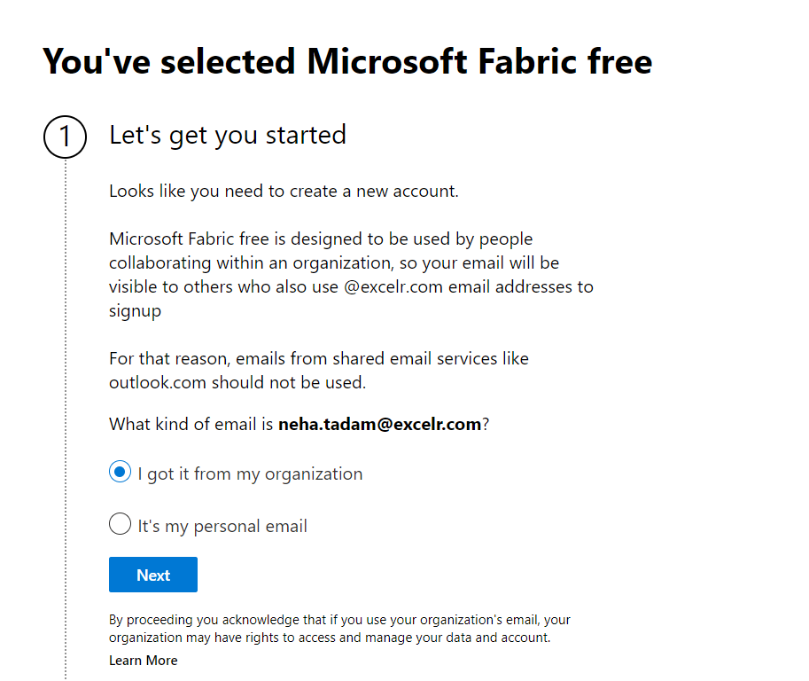

Slide 23
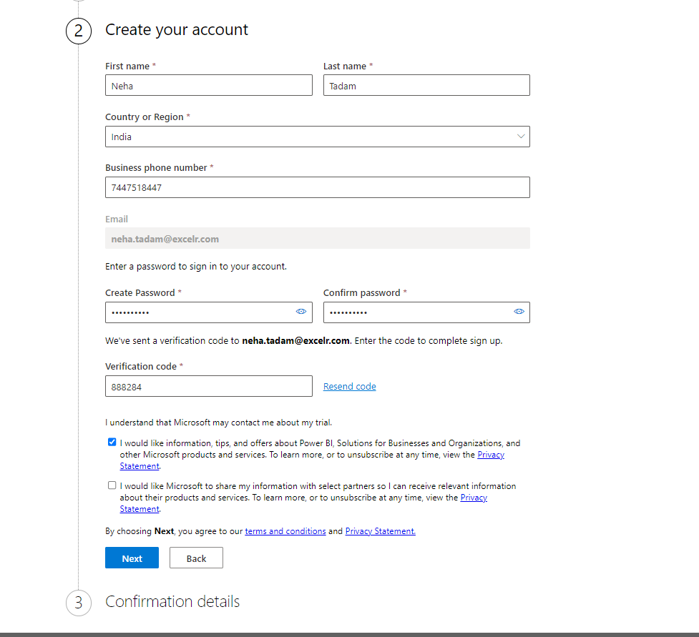

Slide 24
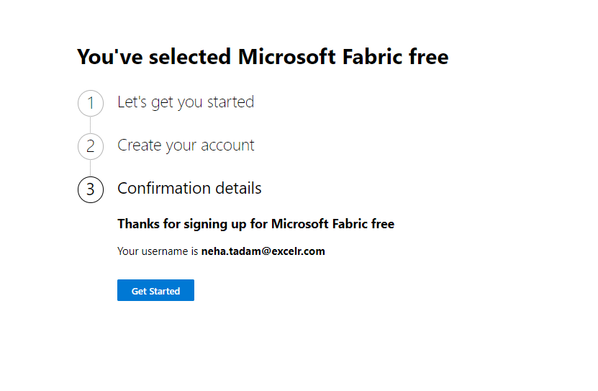

Slide 25
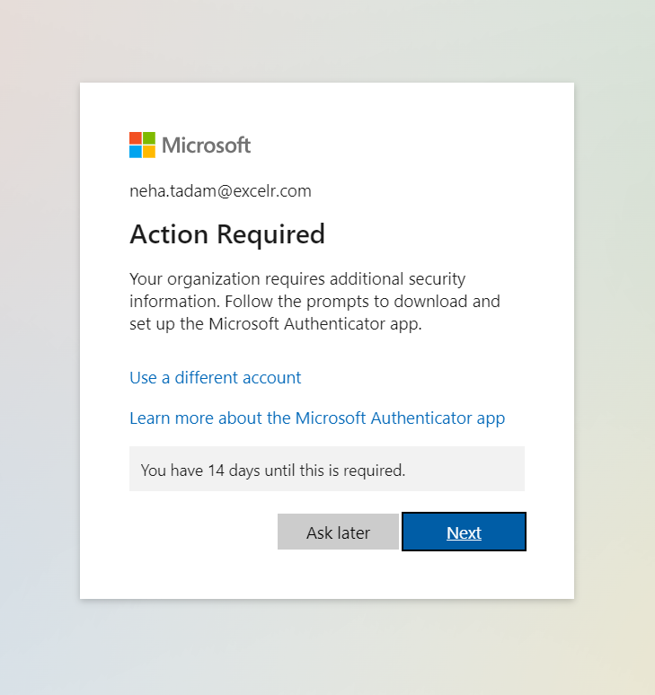

Slide 26
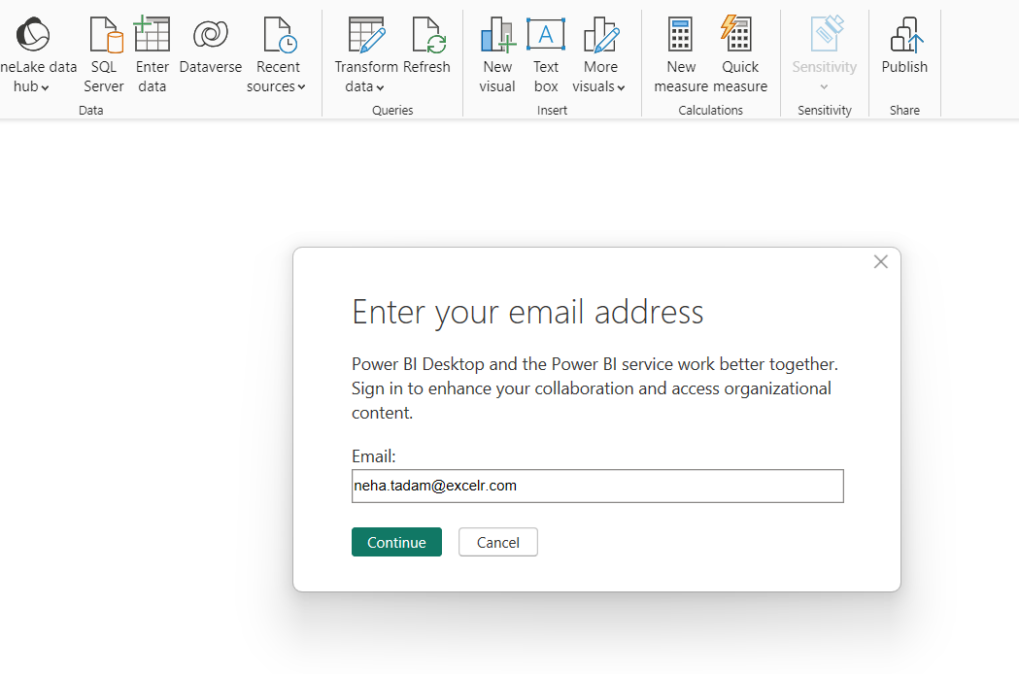

Slide 27
Loading Data From a Folder

Slide 28
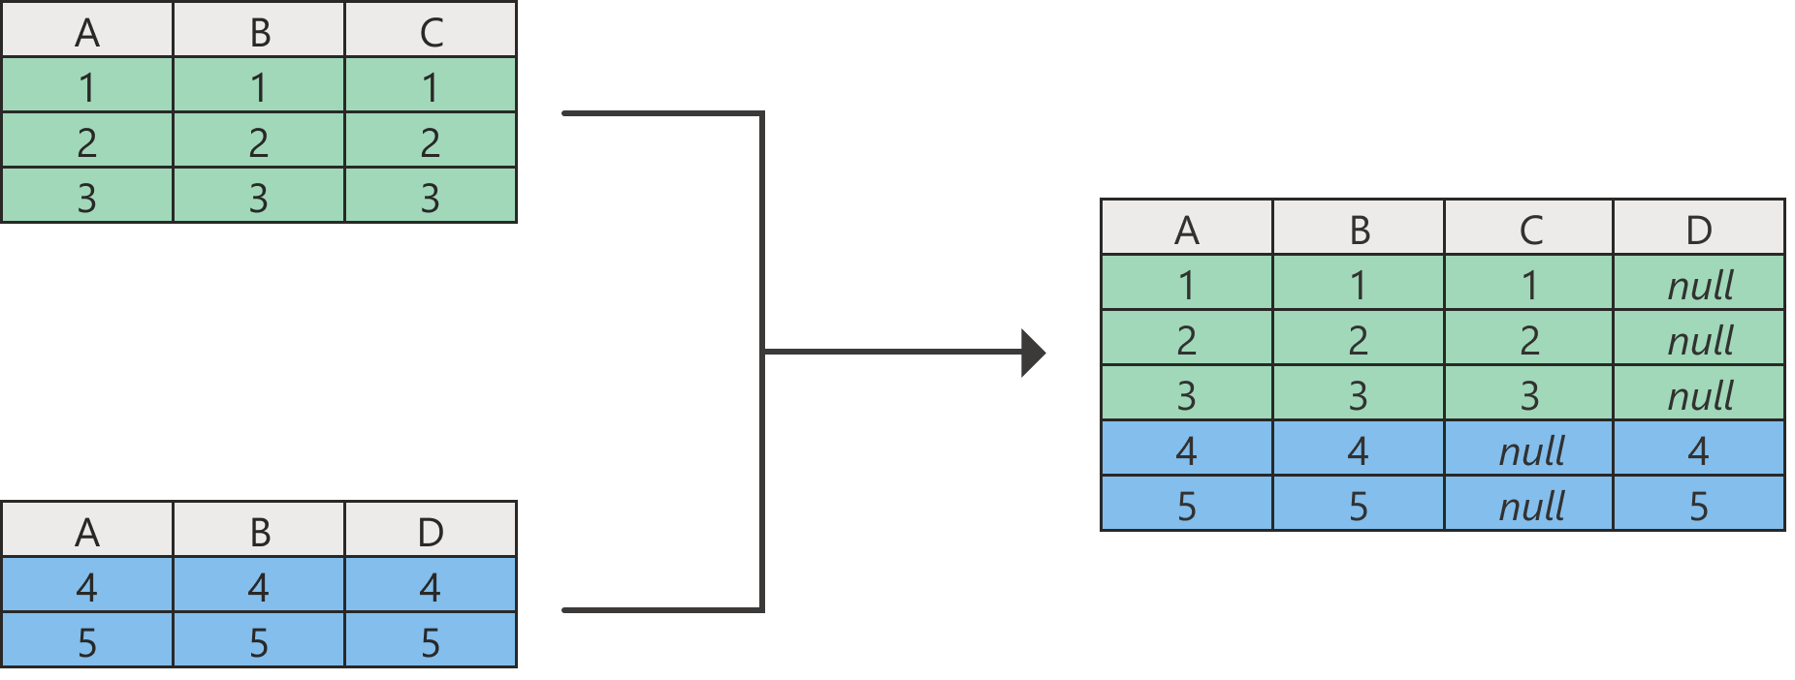
Append Queries

Slide 29
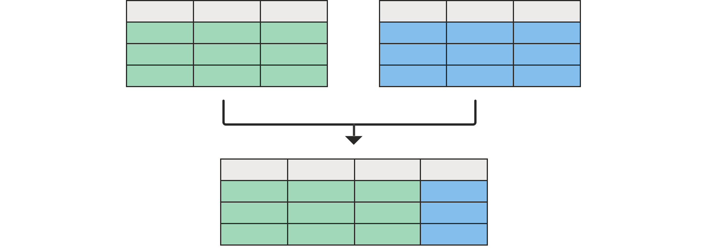
Merging Queries

Slide 30
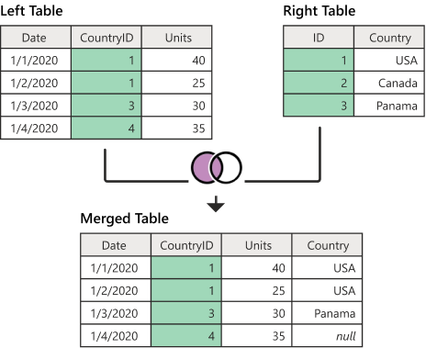
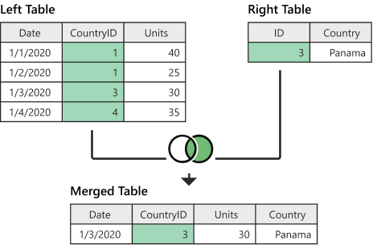
Left outer join
Right outer join

Slide 31
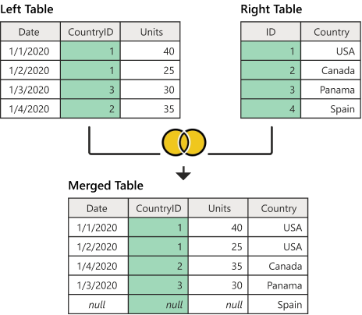
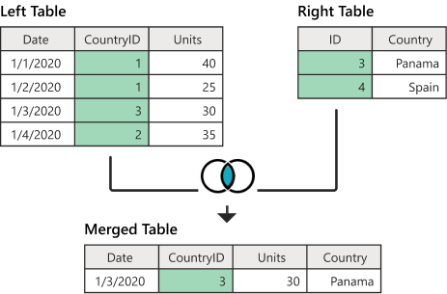
Full outer join
Inner join

Slide 32
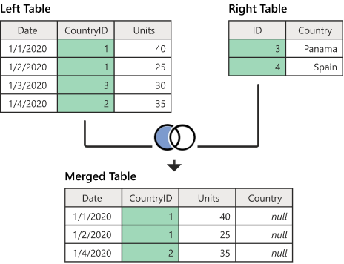
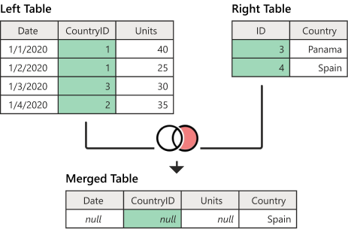
Left anti join
Right anti join

Slide 33
Filtering :
Visual Interaction
Slicers
Drill Through
Drill Down
Filters Plane
Include / exclude

Slide 34
Pivoting :
Moving rows to columns to see different summaries of the source data.
Month | Category | Sales
July | Bikes | 2000
July | Accessories | 500
August | Bikes | 2500
August | Accessories | 300
Month | Bikes | Accessories
July | 2000 | 500
August | 2500 | 300

Slide 35
Pivoting :
Moving rows to columns to see different summaries of the source data.
Month | Category | Sales
July | Bikes | 2000
July | Accessories | 500
August | Bikes | 2500
August | Accessories | 300
Month | Bikes | Accessories
July | 2000 | 500
August | 2500 | 300
Category | July | August
Bikes | 2000 | 2500
Accessories | 500 | 300

Slide 36
UnPivoting :
Moving columns to rows to see different summaries of the source data.
Month | Bikes | Accessories
July | 2000 | 500
August | 2500 | 300
Month | Category | Sales
July | Bikes | 2000
July | Accessories | 500
August | Bikes | 2500
August | Accessories | 300

Slide 37
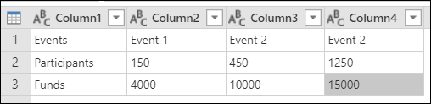
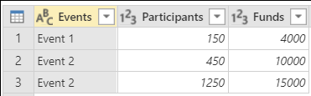
Transpose :
Turns rows into columns and columns into rows.

Slide 38
Transpose :
Turns rows into columns and columns into rows.

Slide 39
Transpose :
Turns rows into columns and columns into rows.

Slide 40
Transpose :
Turns rows into columns and columns into rows.

Slide 41
Transpose :
Turns rows into columns and columns into rows.

Slide 42
Transpose :
Turns rows into columns and columns into rows.

Slide 43
Transpose :
Turns rows into columns and columns into rows.

Slide 44
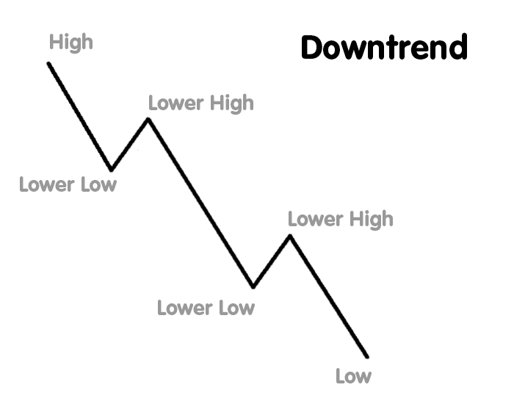
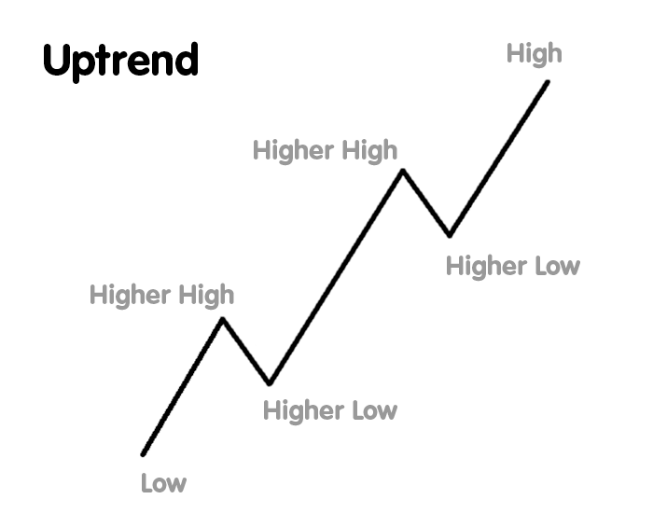
Trend
the direction of change in a numeric data with time

Slide 45
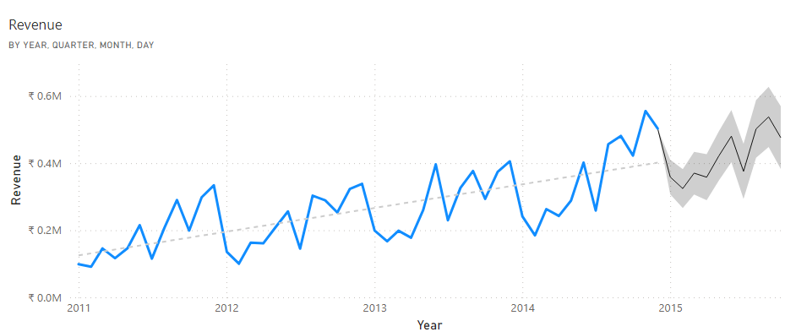
Pattern
Repeating fluctuations of data over time

Slide 46
Pattern
Repeating fluctuations of data over time

Slide 47
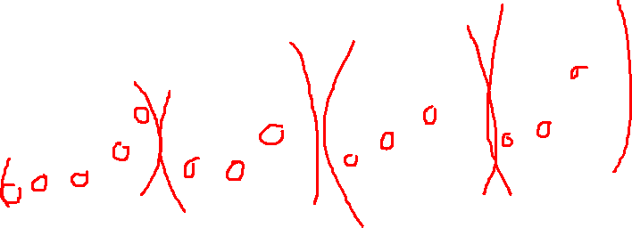
Pattern
Repeating fluctuations of data over time

Slide 48
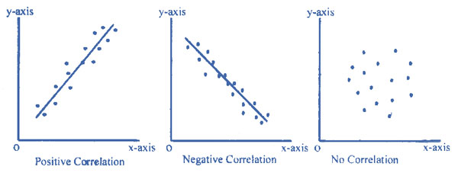
Correlations
the relationship between two numbers

Slide 49
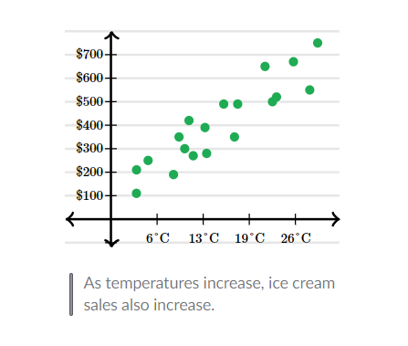
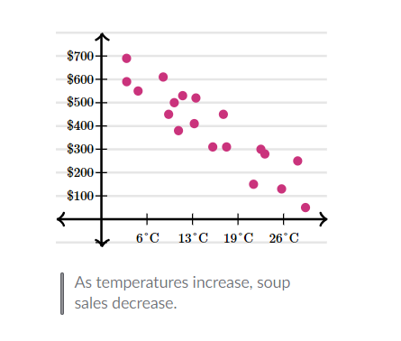
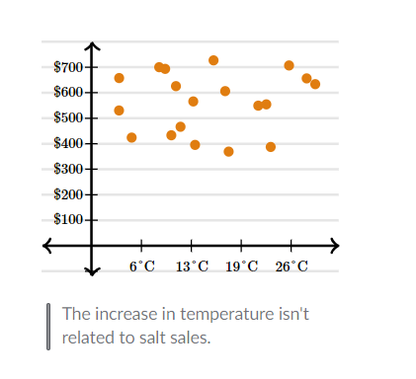
Correlations
the relationship between two numbers

Slide 50
Exploring In-Depth Insights
In Power BI, there are several features and techniques to explore insights in-depth.
Some key approaches within Power BI:
Drill Down
Drill Through
Tool Tips
Navigating from summarized data to more detailed levels within the same visualization.
Moving to a dedicated page with detailed information specific to a data point in a report.
Displaying additional information upon hovering over a data point in a visualization, providing on-demand insights.

